Slide 1


Supply Chain
Enterprise Platform
Powered by Blockchain
DISRUPTING BUSINESS PROCESSES,
ONE BLOCK AT A TIME…
COMPANY PROFILE
Delivering Business Transformative Solutions

Slide 2










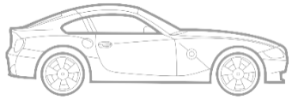












About Real Variable
BLOCKCHAIN ACHIEVEMENTS
5 Private Chains
30+ Blockchain Architects
60+ Nodes
200+ Party Ledgers
600,000+ Events
1 Million + Parts
Hybrid networks
Real Variable is a Blockchain powered SCM enterprise platform & solutions company with operations in India & USA. We leverage emerging technologies to enable digital acceleration and cost saving benefits to organizations.
PROBLEM STATEMENT
“ Globally organizations need “One Digitally Secured Platform” to establish product origin, track & trace, CoPQ, and obtain product lifecycle data points from multiple enterprises across value-chain because today’s ERPs are designed only for Tier 1 Trading partners “
PLATFORM & APPS
Supply Chain
TECHNOLOGY USP
Blockchain Technology
Distributed Ledger Technology
Smart Contracts Algorithms
Zero Code Platform
Dynamic UI
Matching engine
Actionable Intelligence
1/3rd Time & Cost to Customize
1
Supplier
2
Logistics
3
Production
4
Distribution
5
Customers
6
After Sales
7
Products
REALCOLLAB
REALTRACEABILITY
REALWARE
REALRECO
REALO2O
REALWARRANTY
Supply Chain Collaboration
Track & Trace
Blockchain Platform
Distribution
Automation
Hyper Local
E-Marketplace
Supplier Warranty
Recovery
Co-innovated
SECTORS
Consumer
Electronics
Automotive / EV
Logistics
FMCG / Diary
Aviation
Healthcare / Pharma
CREDENTIALS
MARKET SIZE
USD 7.60 Billion
USD 9.8 Billion
USD 3.1 Trillion
Addressable market size for RealWare & RealApps
Global SCM Blockchain market size by
2025 @80.2% CAGR (Source: Allied Market Research)
Global Logistics & Supply Chain Market size by 2021 (Source: Research and Markets)
INTER-OPERABILITY
GLOBAL Offices
Houston, Texas, USA
Hyderabad, India - Global Development Center
And many more… RealWare can connect to all systems / platforms through API connectors for data exchange

Slide 3


Real Variable – Blockchain Case Studies
Problem Statement | BMW APAC Dealers / Customers do not have order ETA updates due to multi level aggregation of orders and bulk shipments. | DHL incurs working capital about USD 300 M towards OEM / Dealers advance customs and duties payments for cargo clearance. | The average TAT For 1500+ dealers of Nissan for stock replenishment is about 2-3 weeks.
Solution Provided | Order / Shipments / Part Track & Trace with Real time ETA update to Dealers / Customers | Global Shipments Tracking / Surface, Ocean, Air Cargo/Customs Payments | Dealer Stock Visibility, Dealer to Dealer Stock Replenishment (Phase 2)
Solution Description | This solution is primarily for traceability of the spare part shipment from the BMW’S regional distribution center to dealer network spread across 21 countries and used by over 200+ Dealers in APAC region. Solution is live since 12 months. | This solution includes Ordering, Invoicing, Reconciliation, Payment settlements and Reversals especially for transactions involving cross border shipments between Dealer, OEM, DHL, Bank & Customer. Some of the functionality is also made available on the mobile application. | This solution provide transparency to Dealer Network on Stock availability, Stock allocation, estimated time of departure, arrival notification including track and trace. This is solution is going to be used by 1250+ Dealers across USA, 250+ Dealers in Canada.
Value Proposition | Dealer / Customer satisfaction with real time tracking of order placed and cuts down manual coronation process between multiple organizations. | Global clients cargo supply chain movements tracked on real time giving customer goods ETA. For DHL it cuts down about USD 300M working capital paid for custom duties in advance for clearing goods and collected later from customer. Cuts down payment process time from T+7 days to T+2 days. | Just in time inventory levels at dealer & warehouses across US, Canada and Japan. Dealer stock replenishment time is cut down from T+3 Weeks to T+1 week. Nissan will have better visibility of dealers & warehouse stocks and helps is aggregating shipment orders.
Reference Link | Proof Of Concept (Jul 2019 Video): https://youtu.be/KeMGcKn-EmI | https://www.linkedin.com/feed/update/urn:li:activity:6666644592470855680/ | The Dealer Stock Visibility solution has gone live recently
3

Slide 4



Real Variable – Blockchain Case Studies (WIP)
Problem Statement | Vodafone does not have the visibility to track the orders and monitor the performance of shipping partners | Lack of information exchange between the air cargo networks, real time visibility of data at various check points in the port to port shipments which includes billing & Payments | OEM does not have the visibility of the ETA and ETD changes to the shipment and stock related information at the 3rd party warehouse (incase of partial shipments at the destination)
Solution Provided | (TransFer) Order /Shipments/ Track & Trace / Returns / Analytics | (TransAir) Booking Requests & Confirmations, Track & Trace / Rates/ Billing/Invoicing and Reconciliation | (TransModal) Order / Shipments / Track and trace / cancellations / Stock or warehouse Management
Solution Description | This solution enables full traceability of orders to the granular level with almost 300+ check points, they can also monitor the performance by total orders delivered, returned and lost. Comparison of data by monthly and annual. About 2 M+ transactions/month | Automates the rate and booking requests, seamless work flow of booking, confirmation, amendment & cancellation from different carriers, invoice reconciliation | Network includes consumers, shipper/OEM-warehouse, OEM/shipper, Pre-carriages/trucking, forwarder/agent, Export and Import Terminals and carriers. The application enables end-end traceability of transport/shipment data on real time.
Value Proposition | Cuts down process time from T+15 days to T+7 days. Reduction of delivery cost, improve the courier partner performance with timely reports, reconciliation of payments | This will ease the business, improve transparency in the overall system and reduce reconciliation times. | Timely planning and execution of deliveries, inventory management at warehouse level, order vs production management
Participating Orgs | DHL, Vodafone (Germany) | DHL, Nippon Cargo Airlines (Japan) | DHL, Maxion, Yusen, Transfesa (Spain)
4

Slide 5









Leadership Team
Complimentary skill-sets with professional, technical, functional & business experience
Krishna Meka
Lakshmi Venkat
Ram Patnala
Venkat Kuramu
Founder & CEO
Founder & CTO
Founder & COO - US
Delivery Manager - VP
20+ years as Venture Capitalist;
Inv., built & exited ~10 Co.’s
18 + yrs. of Technology in
TCS, Dhanush
USA: 20+ years of experience in SAP and Data Analytics
15+ years of experience,
ex. VMWare
Vinod Kumar
Kiran Prakash
Sara S
Team
AVP Sales
AVP Pre-Sales
AVP US Sales
30+ People
15+ years of experience in B2B/B2C enterprise solution sales
10+ years in SCM Products.
ex-TCS, JPMC. Ramco Systems
10+ years of experience in consumer goods & automotive
Hyderabad, India : Tech Dev. Team; Business & Finance Team.
5

Slide 6

Our SCM Platform & Solutions…
Business Transformative Solutions - Powered by Blockchain

Slide 7









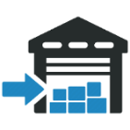





SCM Industry Pain Points
SCM is fragmented, need for digital connectivity
Multiple entities, systems & data silos
Demand Generation & Fulfillment
Part Traceability & Visibility
Distributor /Dealer management systems
Inventory – Over/ Understocking @ strategic locations
After Sales Warranty Recovery
High Cost of Poor Quality
Reconciliations Challenges
Trade Plans & Financial Transactional Disputes
Auditable Ledgers & Records
Unmet need in last mile “One Digital Platform”
Salesman order-booking from App to fulfillment & payments automated
Stores 1
Sub-Ds 1
Stores 2
Customers
OEM Current Process
Branch 1
Sub-Ds 2
Stores.. nth
OEM/ WH
Hub
Sub-Hub
Branch 2
Sub-Ds.. nth
OEM’s Concerns
High cost of multiple applications & integrations
Secured digital open framework
Data Protection & Privacy
One stop E2E Solution “RealReco”
OEM – WH - Distributor – Branches – Sub-Ds - Stores - Customers
Why Real Variable…..Zero Code digital Platform can easily customize need of each entity automation and connect digitally with one platform across SCM value chain
Branch .. nth

Slide 8

















Our Solutions …. Connecting Supply Chain Data Events
Suppliers
Logistics
OEM
Dealers ERP
Stores
Customers
After Sales
Traceability
In-Transit Tracking
Business Visibility
DMS/WMS
Stores Mgmt. System
Doorstep Sales
Warranty
RealCollab App
Suppliers Supplier
Price Quotes/Inventory
PO Tracker
SKU Tracker
Barcode / QR Scan
Shipments ETA
WH Notifications
Quality / GRN
Delivery Confirmation
Invoicing
Digital Payments
Reconciliations
Auditable ledgers
RealLogiTech App
Ocean
Air Cargo
Surface
Dealer Orders ETA
Customs Payments
Orders/Part Tracker
Delivery Confirmation
Return Management
Multiple Logistics
Digital Payments
Cold storage temp. IoT
RealWare Platform
Real Time Dashboard
Master Reg. Control
Suppliers Tracker
Dealer Network Tracker
Goods in-transit Tracker
Vendor Inventory Mgmt.
Salesman Perf. Tracker
Anti Counterfeit Mgmt.
Secondary Sales
Returns/Claims
Trade Promotions
Payment Reconciliations
Credit Limit Tracker
RealReco App
Real Time Dashboard
Stores KYC & Routing
Secondary Order Booking
Stock Visibility
Salesman Performance
Delivery Tracking
Debtors Management
Collections/ Ageing
Returns/Damage/Expiry
Discounts/Rebate
Warranty Claims
Field Service Engg. Tracker
CRM Ticket Tracking
RealMart App
OEM Direct Promotions
Order Booking
Delivery ETA / Tracking
Goods Accept/Reject
Invoice Confirmation
Transaction Statements
Payment O/S
Returns/Damage/Expiry
Discounts/Rebate/Loyalty
Warranty Claims
Field Service Engg. Tracker
CRM Ticket Tracking
Customer Sales Automation
RealO2O App
OEM Customer Reach
Geofenced Stores
Product Availability
Order Booking
Delivery ETA/Tracking
Delivery Confirmation
Payment Confirmation
Provenance
Warranty Claim
Customer Service Rating
Loyalty Points/Coupons
OEM Brand Promotions
RealWarranty App
Warranty Claims
Warranty Verification
Service Engg. Report
Replacement / Repair
Claim Certification / ETA
Supplier Traceability
Warranty Contracts Terms
OEM Notifies Supplier
Supplier Approval
Replacement Approval
Claim Ticket Closed
OEM Claim Recovery from Supplier
Real Fin
Smart Contracts
Auditable
Transaction
Ledgers
Claims /
Rebate Mgmt.
Tool
Cash/Digital
Payments
Bank Auto
Reconciliation
Debtors /
Credit Limit
Mgmt. Tool
Payment
Auto
Notification
Contractual
Terms Auto
Verification &
Recovery
DATA TRUTH ACROSS SCM VALUE CHAIN
External Data Integration Layer
Web
Mobile App
NFC
QR
Barcode
RFID
IoT
Accounting
Systems
ERP’s
GPS
SMS
WhatsApp
Push/Pull Data

Slide 9

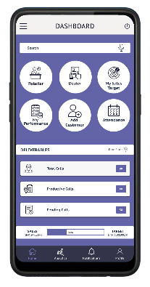
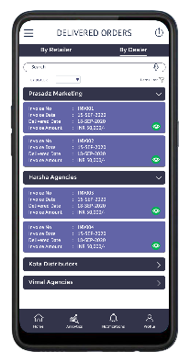
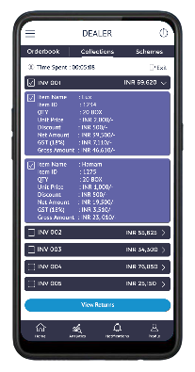
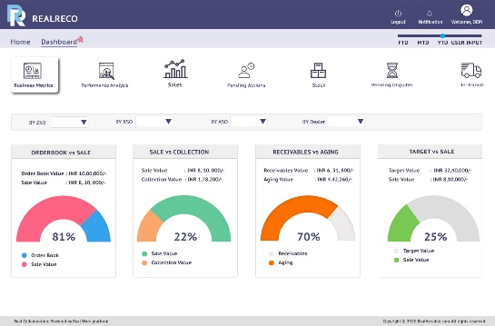
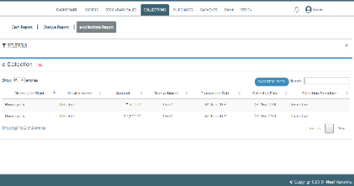
RealReco Solution
Next Gen Dealer Management System
Dealer Order Booking
01
07
Field Automation & Geofence Attendance
Invoicing, Aging Analysis & Credit Limits
02
08
Stock - Visibility, Allocation, Transfers & Stock out
In-transit Delivery Tracking
03
09
Salesman Productivity, CFR, Line Fill Rate
Digital Delivery Confirmations & Returns
04
10
Trade Plans & E2E Reconciliation
Payments & Collections
05
11
Analytics on Tamper Proof Distributed Ledgers
Inventory Optimization & ABC Profiling
06
12
Real-time Reporting & Dashboards
Sales Orders App
Delivery App
Collections
Web Interface
Customizable Dashboards

Slide 10


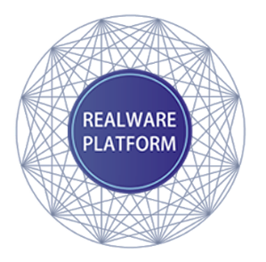
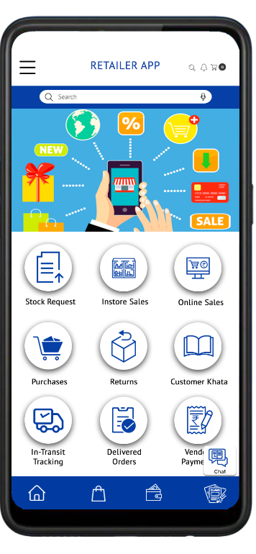
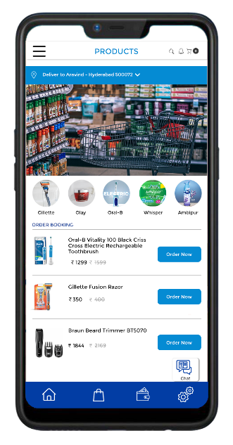




















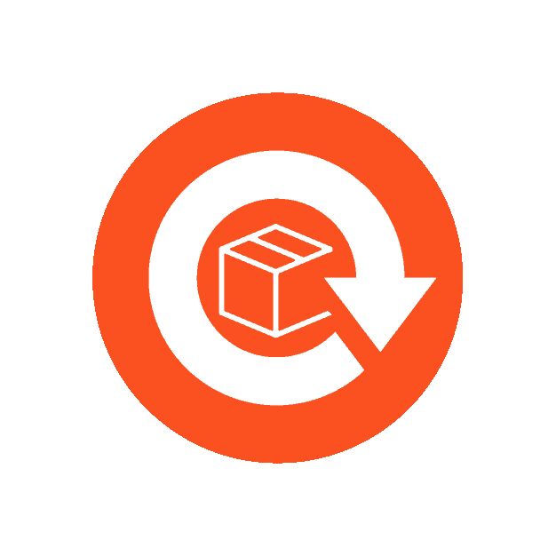
RealMart Solution
Smart Retail App in App solution connecting OEM’s to last mile Stores and Consumers
BACK END
FRONT END
RealReco
RealWare
RealMart
RealO2O
OEM DMS Tool
Processing Platform
Retail Store App n App
Consumer App
Consumers
Stores
Dealers
Blockchain powered AI
based routing platform
Branch
Zero Code Platform
Dealer
Dynamic UI
Hub
Dynamic API
Retailer Customers
Smart Contracts
Salesman
WH
Matching Engine
OEM DMS SOFTWARE
Blockchain
Nearby Stores
Digital
Promotions
Retailer Ordering
Digital Payments
Receipts & Accounts Outstanding Statements
WhatsApp
Share
Facebook
Instagram
Stock Replenishment
Online Order
Message
Order
Video Search
Voice
Over

Slide 11
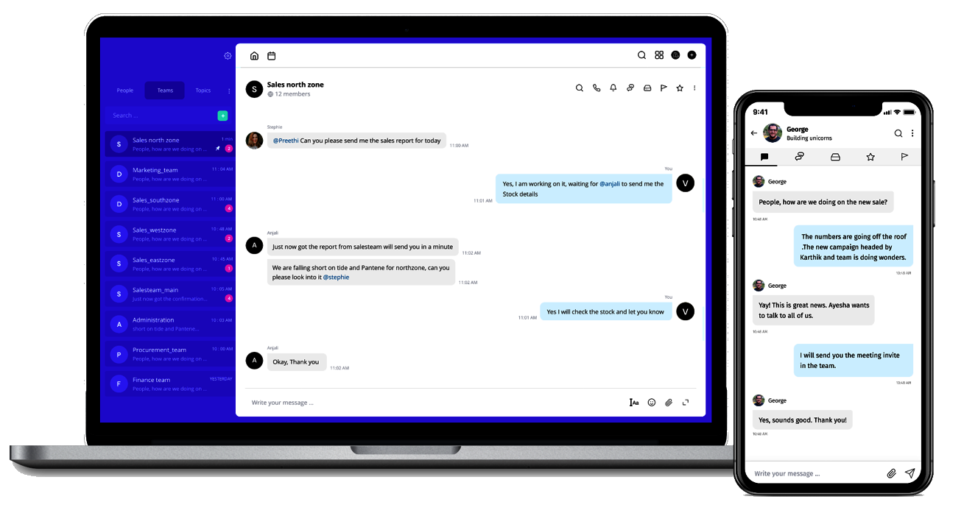






Communication & Collaborative Features
Interactive communication across value chain till Stores
In-built additional feature like Microsoft Teams / Google Hang Outs / Slack for establishing communication with hierarchical managers and their support staff on field to get the actual on ground situation for faster decisions & approvals
Messenger/Groups
Voice / Video Calls
Polls
Bot
Notes
Kanban
REAL VARIABLE DOCUMENT DISTRIBUTION CONTROLLED
6

Slide 12
Real Warranty Solution
Supplier Warranty Recovery Solution for OEM, Suppliers
“As per Warranty week estimates; It is said that today the Supplier warranty recovery is around 10 to 17% whereas the fair share of Supplier warranty recovery could be as high as 37% ”
Significant Supplier Warranty Recovery Gap to OEM’s of around 20 to 27%.
(Source: Warranty week )
Ability to trace a part / goods and the identification of a supplier is a Complex process.
Higher Claim volumes & lower claim value discourages the OEMs due to higher supplier recovery costs.
Complex Recovery Process due to claim multipliers between OEM & Suppliers.
Disparate Systems with no information exchange between OEM & Suppliers.
Solution seamlessly complements the existing ERP systems w.r.t Purchase, Sales, Receiving, Shipping, Warranty, Manufacturing transactions.
Smart Contracts gets generated on the Blockchain platform for the forward movement of parts in the value chain from Tier 2 to Tier 1, Tier 1 to OEM, etc.
In case of a claim to OEM, the smart contracts will automatically generate a debit note after executing the back to back warranty conditions through proof of delivery, proof of part usage, Warranty conditions. to its entire Supplier network namely, Tier 1, Tier 2, etc. from where the particular part originated in the value chain.
Traceability of all supporting records in one place for raising debit note & faster addressal of claims and for audit trail.
Cost saving of ~8 to 10% by increased warranty recovery from the Suppliers by OEMs (Source: Estimated through our calculations)
Solution also benefits the Large Tier Supplier to recover warranty from next tier supplier.
System generated Debit Notes on Supplier recovery leading to significant savings on time spent by warranty administrators, managers towards Supplier recoveries.
Data trust increases among entities due to Blockchain technology which brings in immutability, encryption and trust among the participants in the ecosystem and no single entity controls the system.
Reduction in claim disputes incidents with Suppliers.
Industry Pain Points
Blockchain powered RealWarranty Solution
Business Benefits
12
REAL VARIABLE DOCUMENT DISTRIBUTION CONTROLLED
12

Slide 13
Real Collab
Supply Chain Collaboration Solution for OEM’s, Suppliers, Sub contractors
As per SCM Review, the total net benefit increases by 13% with the use of smart contract technology through the blockchain platform.
Industry Pain Points
Blockchain Powered RealCollab Solution
Business Benefits
Manual RFQ, QTN, e-Procurement Supplier Collaboration Process leading to manual efforts in RFQ distribution and re-entering the received Quotation in the ERP system.
Disparate Systems with no information exchange between OEMs & Suppliers.
Ability to trace a part and identifying its origination is a cumbersome process
Lack of visibility for In-transit parts leading to manual efforts in identification of exact part location and estimated ETA.
Manual, paper-based record-keeping on Quotation comparison leading to missed quotations leading to potential audit issues.
Solution seamlessly complements the existing ERP systems w.r.t RFQ, QTN, Purchase, Sales, Receiving, Shipping transactions.
RFQ generated in ERP system can get broadcasted to concerned suppliers through Blockchain platform.
Supplier can respond with Quotations which be easily be integrated back to ERP systems through Blockchain platform.
Dynamic UI based rule engine for quote comparison on different / combination parameters to determine right supplier.
Smart Contracts gets generated on the Blockchain platform for the forward movement of parts in the value chain from nth Tier supplier For e.g. Tier 2 to Tier 1, Tier 1 to OEM, etc.
Traceability of all records in Single system where each party can store and share the information (RFQ, Orders, Invoices, Shipments, Payments, Trade Documents) securely and simultaneously.
Data trust increases among entities due to Blockchain technology which brings in immutability, encryption and trust among the participants in the ecosystem and no single entity controls the system.
Chronological events like Track change / amended orders, PO, shipment notifications, trade documents, receipts, etc.
Comparison & Reduction in errors on POs, Goods receipts, invoices and trade documents due to limited manual intervention.
Tracking of goods by linking physical items to non cloanable QR codes / bar codes, RFID and storing them as a proof of receipt.
13
REAL VARIABLE DOCUMENT DISTRIBUTION CONTROLLED
13

Slide 14
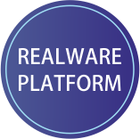

RealWare - SCM Enterprise Blockchain Platform
One stop digital SCM platform accelerates business transformation for your organization
Configurable
Zero Code
RealApps
Dynamic UI
Modular Design
Powerful Customizable Dashboards, Reports & Actionable Intelligence
Rapid deployment of most use cases for any industry vertical @ 1/3rd time & Cost
Robust Security
Smart Match Engine
Integration Friendly
Quick ROI
Three level security architecture: Crypto hashing, Notarization of Assets, control who sees what
Quick payback time and an ROI of at least 200%
Accomplishments
5 Private Chains
30+ Blockchain Architects
60+ Nodes
200+ Party Ledgers
600,000+ Events
1 Million + Parts
Hybrid networks
Client Extensions
Mobile
Web
IoT
Drone
REAL VARIABLE DOCUMENT DISTRIBUTION CONTROLLED
7
Notes:
At RealVariable, our focus is on the “platform” approach. We spent over 18 months developing one platform that works across industry segments.
Our Realware platform is highly modular and shortens development time solving usecases from different vertical
To be precise, our platform does not replace any existing IT solution that has been deployed by the enterprise, rather it sits on top of it extending the reach of data. It’s going to be a crown jewel on the existing IT framework.
Core of our ecosystem is our “Apps” concept. We have developed many Enterprise modules as apps on the platform.
We have also developed a security accelerators that address some limitations of Blockchain technology with respect to addressing enterprise grade security requirements.
The platform connects with existing ERPs and systems that generate data and can have different client extensions.
The platform employs core blockchain strengths such as “Smart Contracts”, “Distributed Ledger” over existing IT framework .

Slide 15
Integration Friendly – API’s
ERP
OEM
WAREHOUSE & HUBS
DEALERS & BRANCHES
STORES
Outbound, Quality, Batch Details GRN, Returns, Inventory, Schemes & Discounts, Disputes
Capture Inbound & Outbound Deliveries, Batch Details, Pricing Contracts , GRN, Returns , Inventory, Collections, payments , Schemes & Discounts, Disputes
Capture Inbound & Outbound Deliveries, Batch Details , Pricing Contracts , GRN, Returns , Inventory, Collections, payments , Schemes & Discounts, Disputes
Inbound, Outbound, Quality, Batch Details GRN, Returns, Inventory, Schemes & Discounts, Disputes
BLOCKCHAIN
Proof of Delivery Contract
Proof of Delivery Contract
Proof of Delivery Contract
Proof of Returns
Proof of Returns
Proof of Returns
Proof of Inventory
Proof of Inventory
Proof of Inventory
Establish condition for Trade Plans Schemes, Discounts & Promotions
Establish condition for Trade Plans Schemes, Discounts & Promotions
Establish condition for Trade Plans Schemes, Discounts & Promotions
Value Chain Participant
Data Structures in DLT
Smart Contract in Blockchain
LEGEND
REAL VARIABLE DOCUMENT DISTRIBUTION CONTROLLED
15

Slide 16







Technology Value Proposition
Platform Architecture : Dynamic UI & Zero code (less than 30 days dev. time)
Blockchain Applications: DLT is applied for event notarization and smart contracts are applied to capture the transaction states of information set before the occurrence of event and post recording of event.
Data Persistence : On-chain & off-chain depending on data privacy
Transaction Volumes : ~4500 concurrent transactions per second
Strong Assurance - Multi Factor Authentication : Private keys, OTP, Biometrics, etc.
Digital Connectivity & Integration : ERPs, Analytics, IoT, AI, multi-cloud approach
Customer Centric App development : Better digital transformation approach Containerization; Continuous delivery; Function-as-a-service; Microservices
Zero Code
Dynamic
UI & API
Data Persistence
Multichain
Digital Connectivity
Quorum
Secure
Authentication
Smart Contracts
Hyperledger
Digital Transactions
Blockchain Applications

Slide 17






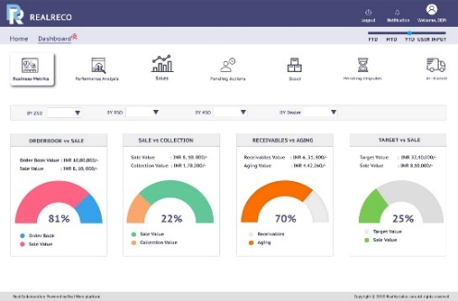




Business Benefits Resilience
Next Gen SCM digital solution for growing organizations
Cost Effective Solution
Productivity
Actionable Intelligence
Business Performance
60 - 70%
30 - 40%
Up to 80%
10 – 15 %
Zero Code Platform
PaaS/SaaS
Higher workforce productivity
Real Time Trusted Data Capturing
Additional earnings and cost savings
Rapidly Adapt & Automate
Quickly streamline operations with easy onboarding and integrations and customize new workflows using low code tools
Sales and Inventory
Agile Supply Chain
Enable your workforce with new digital capabilities for sales growth and minimize stock out situations
Adapt quickly to disruptions with end-to-end operational visibility
Security & Auditable Records
Disrupting Business Processes OEM to Dealers…
Business Insights & Analytics
Built-in technologies help you with auto reconciliation and protect your digital assets/data across multi-party open digital frameworks
Accelerate Business insights with analytics and AI to make informed decisions and plan for what's next
Remote Teamwork
Product Tracking & Traceability
Empower collaboration and help employees stay connected while limiting meeting fatigue
A complete manufacturing Track & Trace systems to improve business efficiency across multiple entities, digital provenance and anti-counterfeiting
Cloud
Trade Plans & Offers
Rapidly scale operation as needed while improving operational stability and network resilience
Manufacturers can promote their trade plans & new product promotions with points/credits by connecting directly to Retailers & Customers
REAL VARIABLE DOCUMENT DISTRIBUTION CONTROLLED
8

Slide 18



Slide 19

APPLICATION SCREENSHOTS
Business Transformative Solutions - Powered by Blockchain

Slide 20
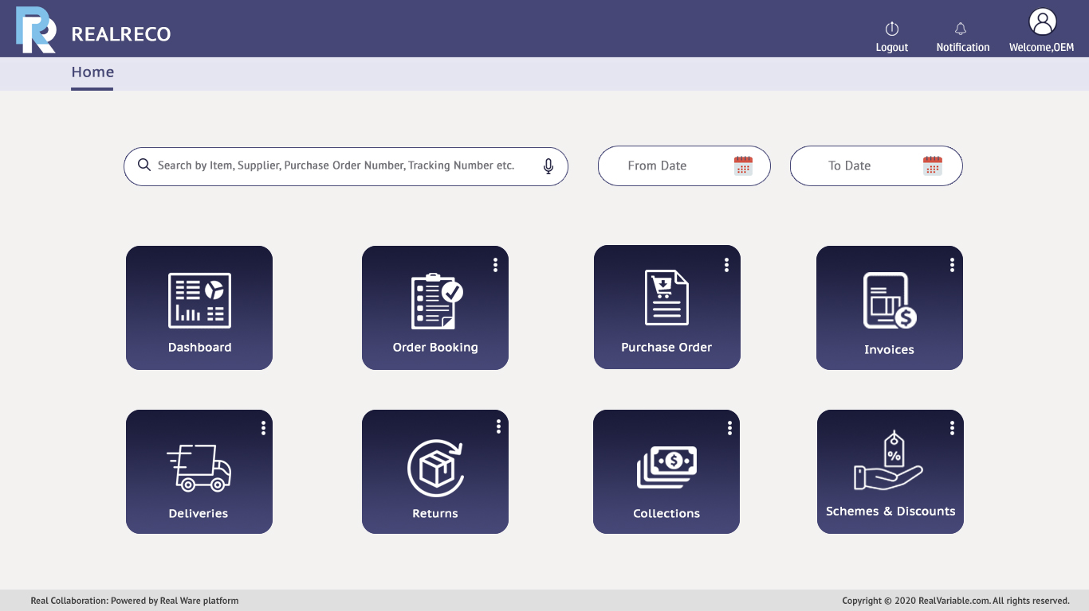

Slide 21
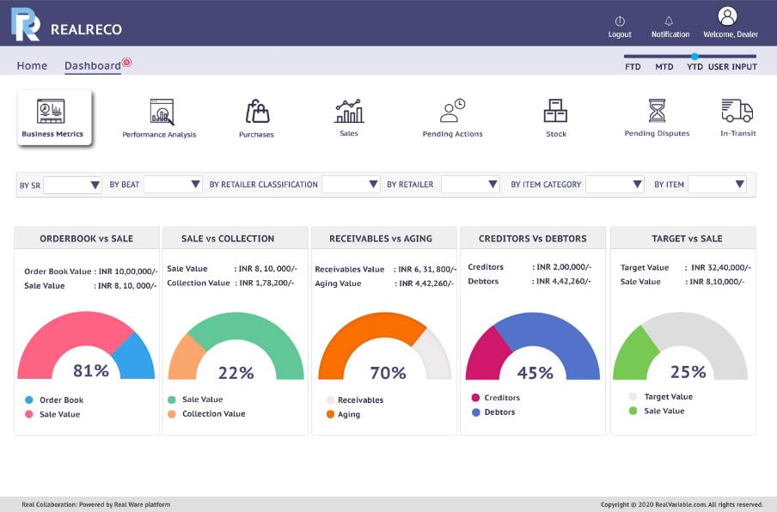
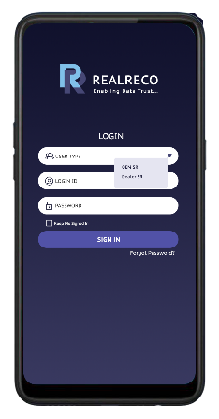
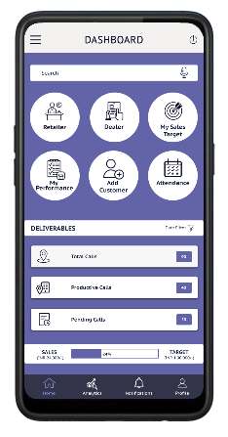
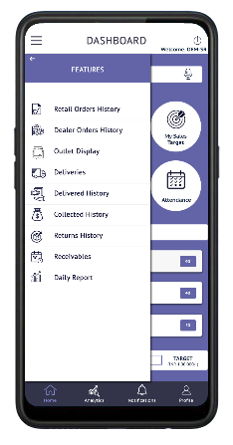
Solution Screenshots

Slide 22
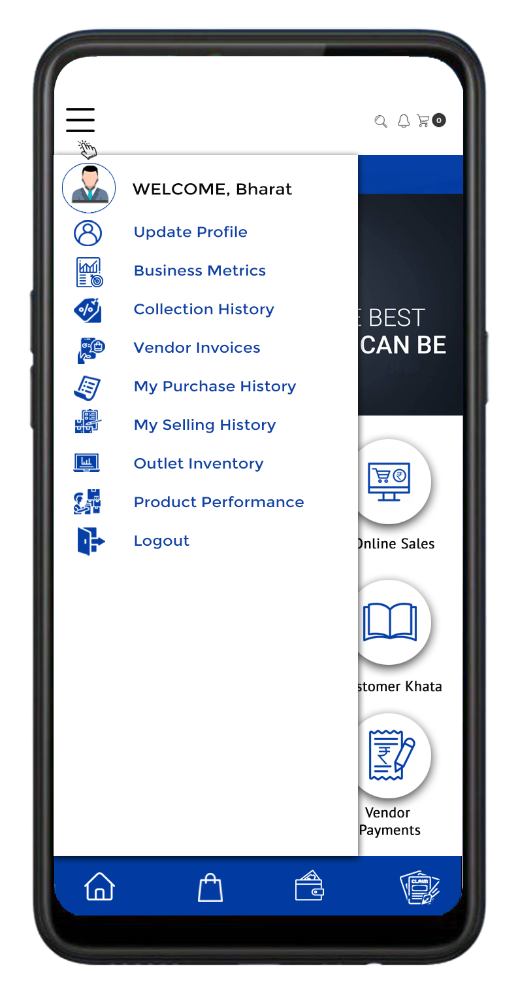
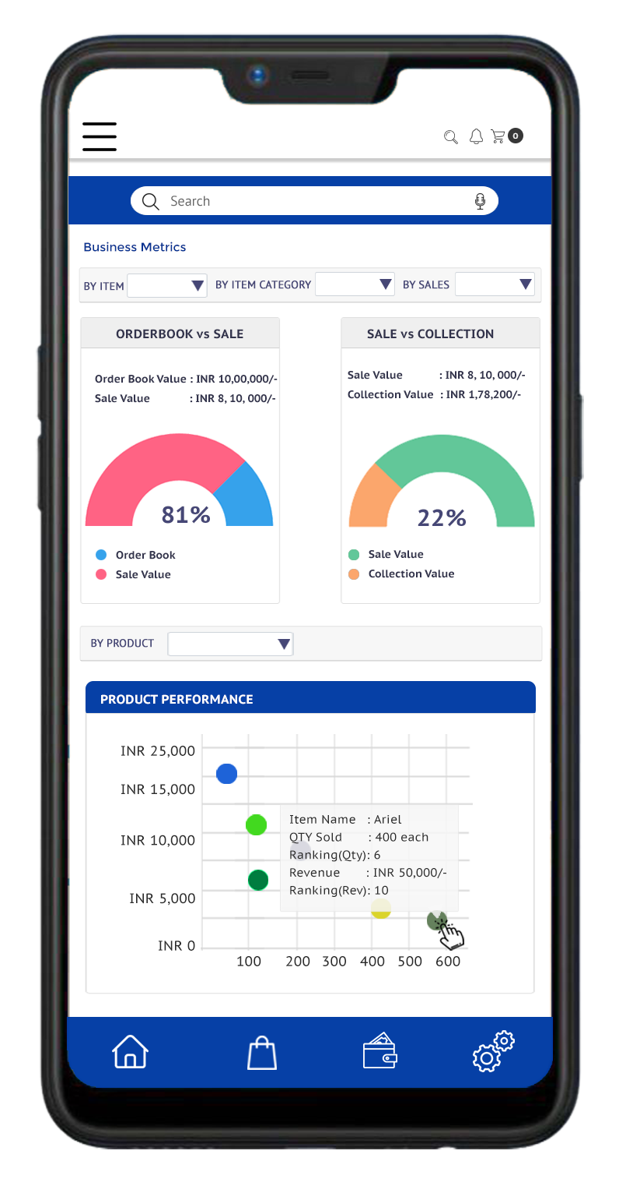
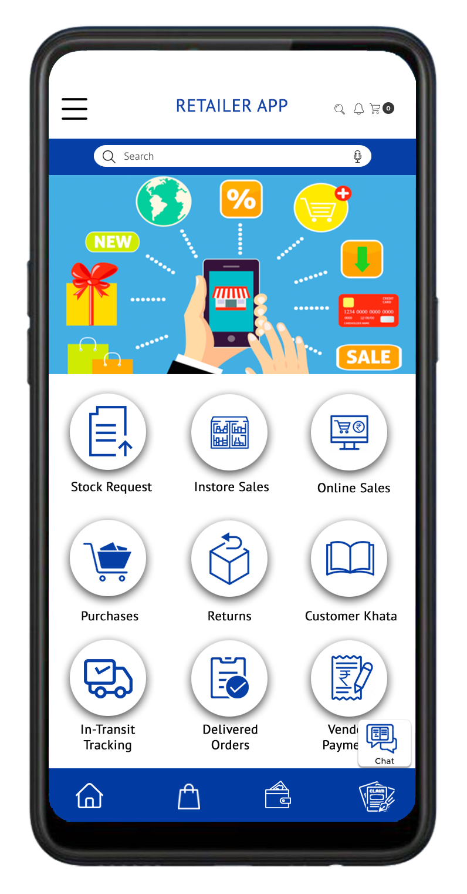

Mobile App
Slide Menu
Business Metrics
Home Page Dashboard
Retailer Order Booking
REAL VARIABLE DOCUMENT DISTRIBUTION CONTROLLED
16

Slide 23


Thank you
UNITED STATES:
800 Town and Country Blvd., Suite 300, Houston, Texas 77024
Email: ram.patnala@realvariable.com
INDIA:
1st Floor, Pearl Enclave, Road No. 5, Banjara Hills, Hyderabad – 500034
Email: krishna.meka@realvariable.com
#20t8h1a14n11k25y15o21u

